Slide 1
walkthrough vertical prototype

Slide 2
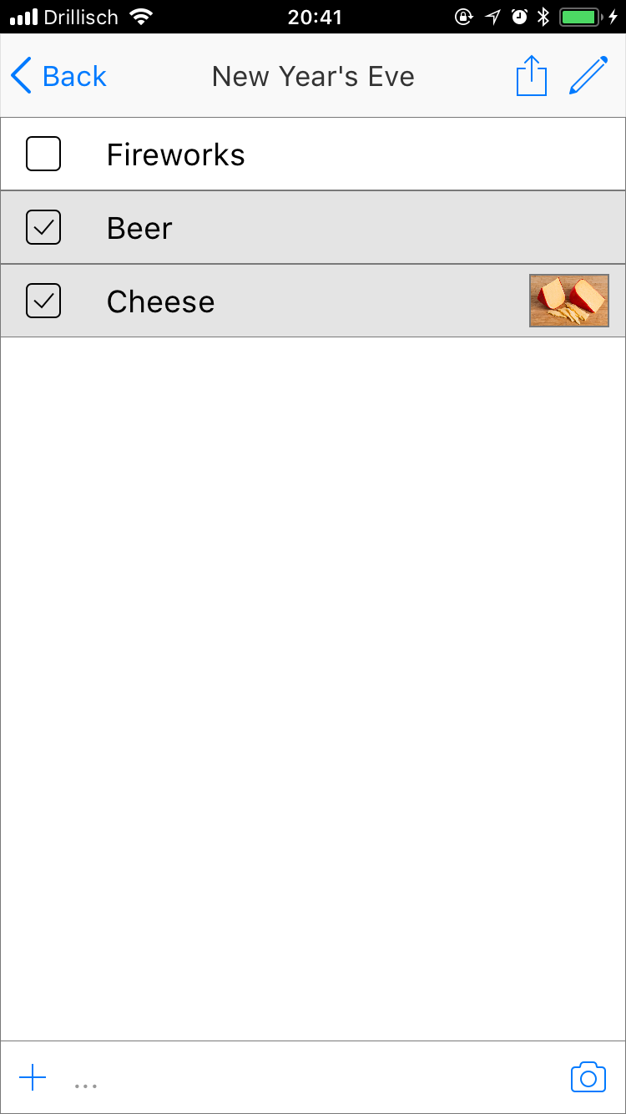
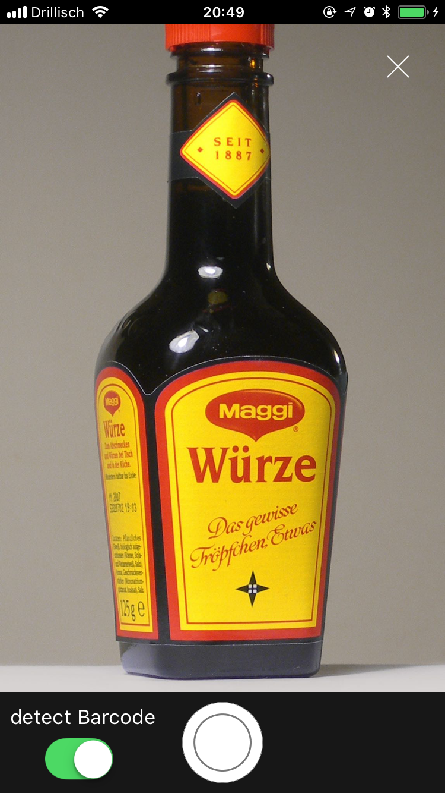
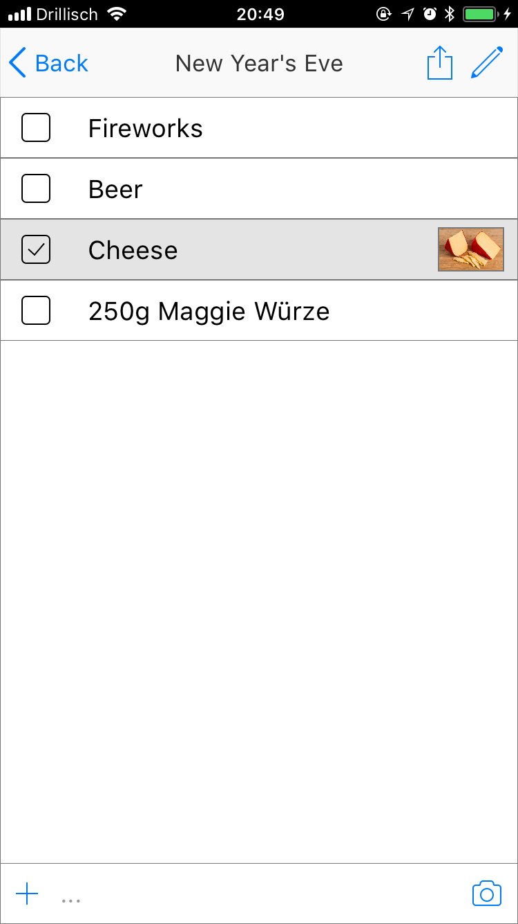
Instead of adding an item manually one can also scan the barcode by checking the „detect Barcode“ slider in the camera screen.

Slide 3
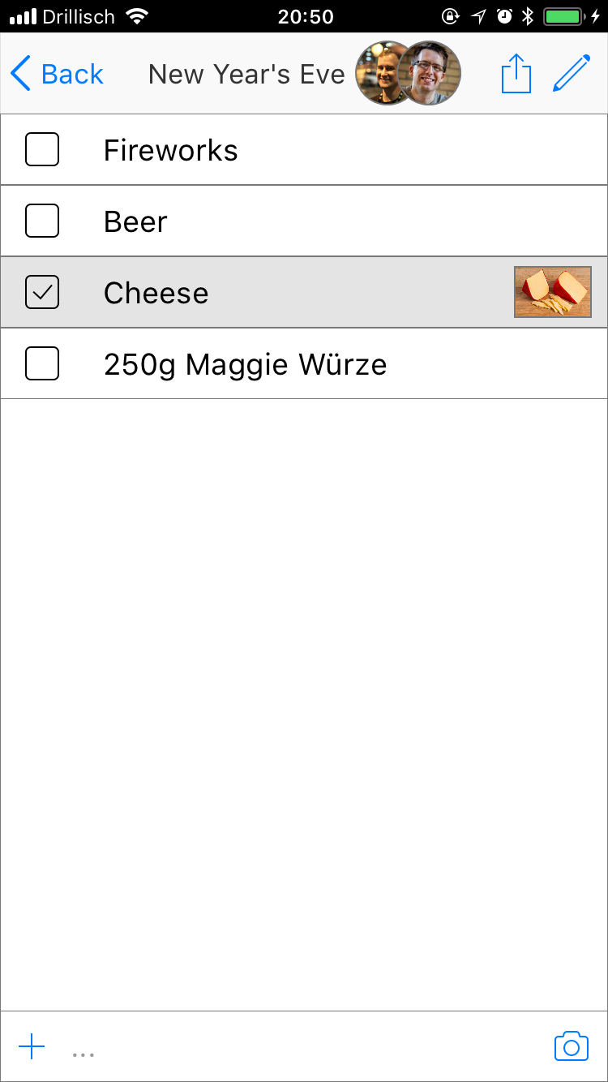
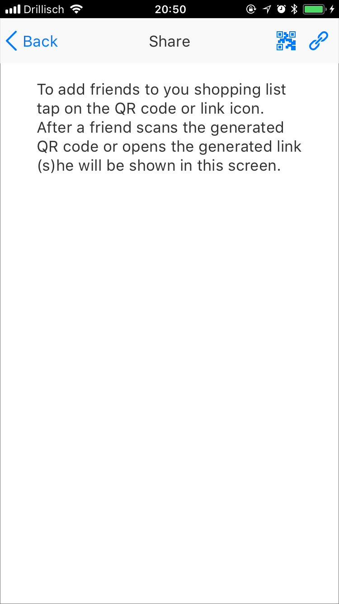
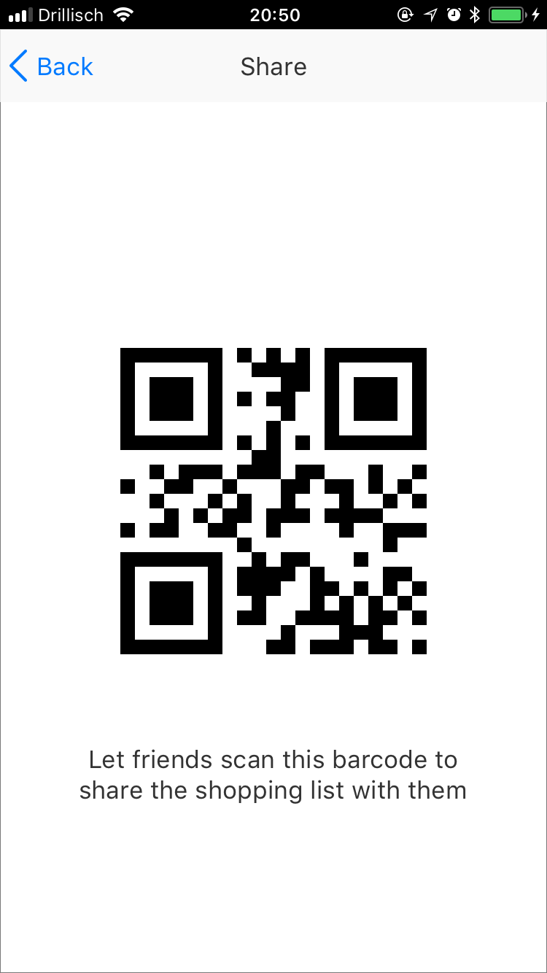
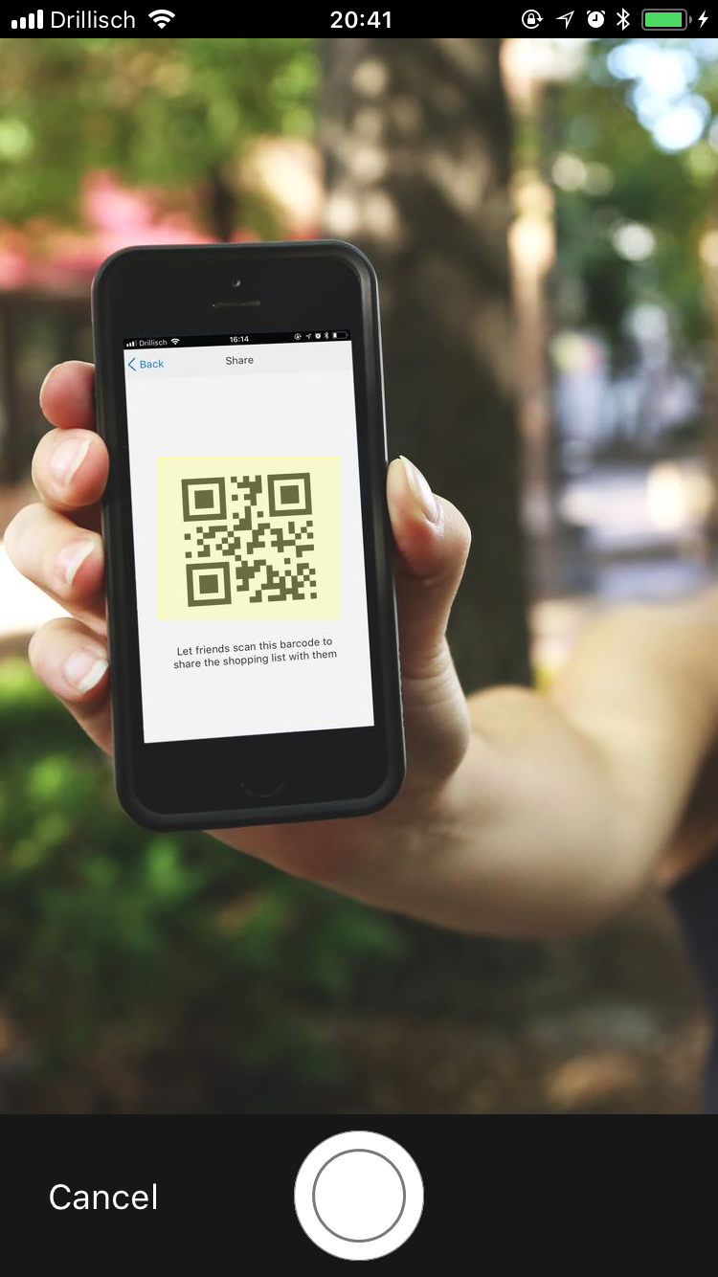
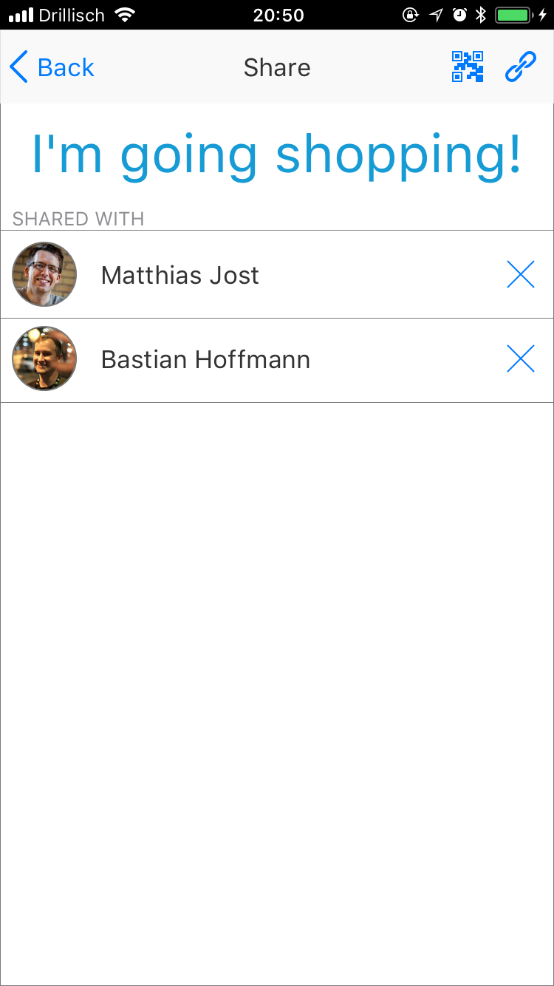
To invite friends to share you shopping list with you you have to hit the share button next to the pen in a shopping list to open the share screen. There you hit the QR Code button again at the top of the display to create a QR code and let your friends scan it. Afterwards they will be displayed in the share screen.

Slide 4
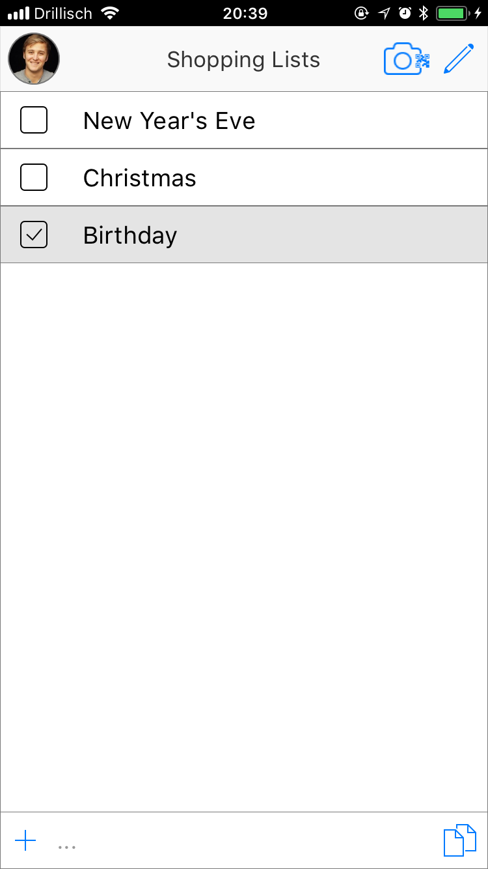
To join a friends shopping list you have to go to the home screen and hit the Camera symbol with QR Code attached in the top. Then you just have to hold the phone over the QR code.

Slide 5
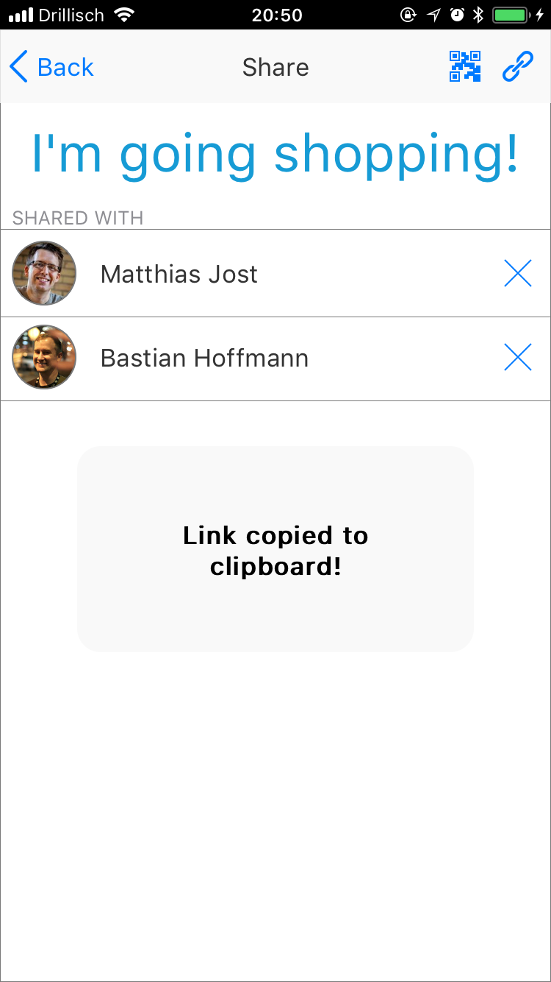
Instead of using the QR Code you can also invite friend with a link by pressing the chain symbol next to the QR code button in the share screen.

Slide 6
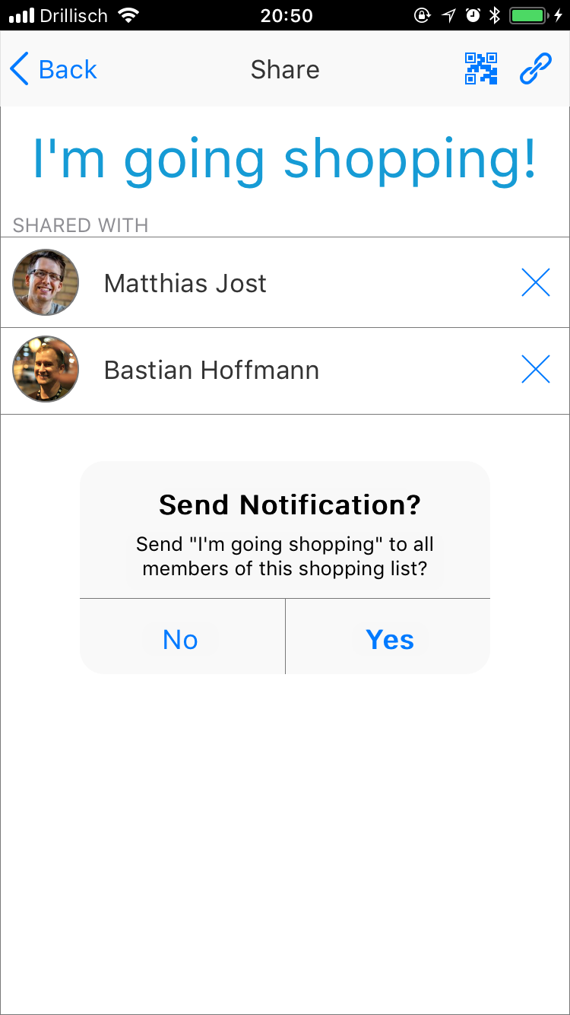
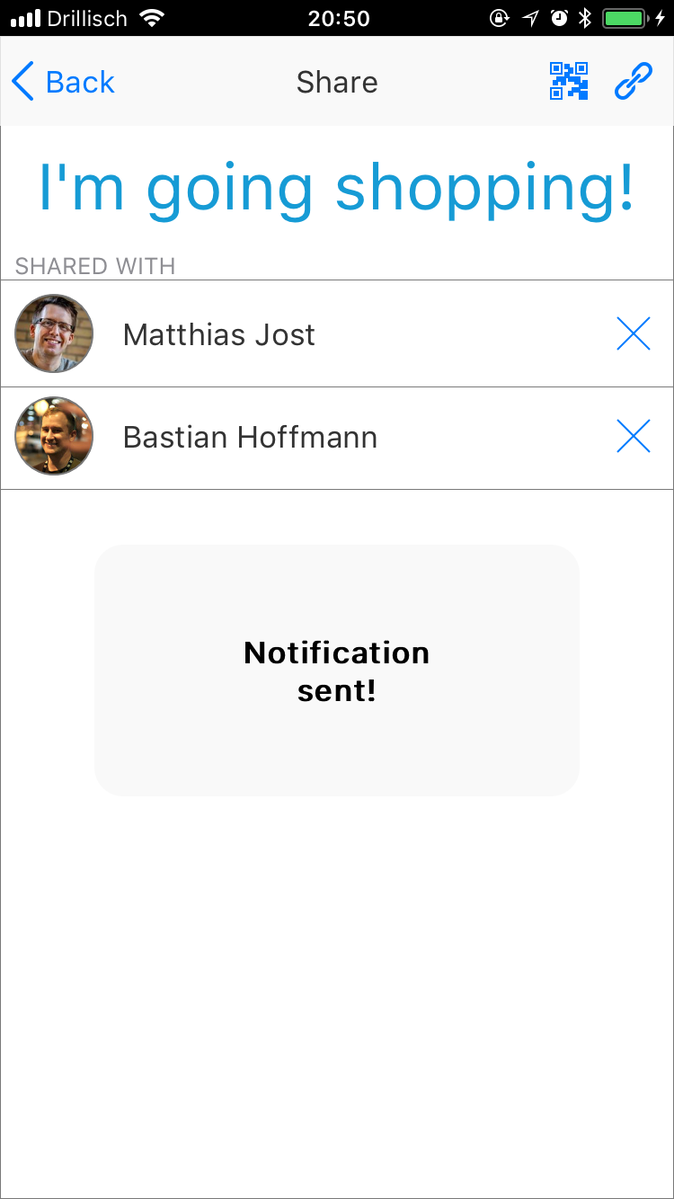
To send a notification click on the „I‘m going shopping!“ text and confirm with yes.

Slide 7
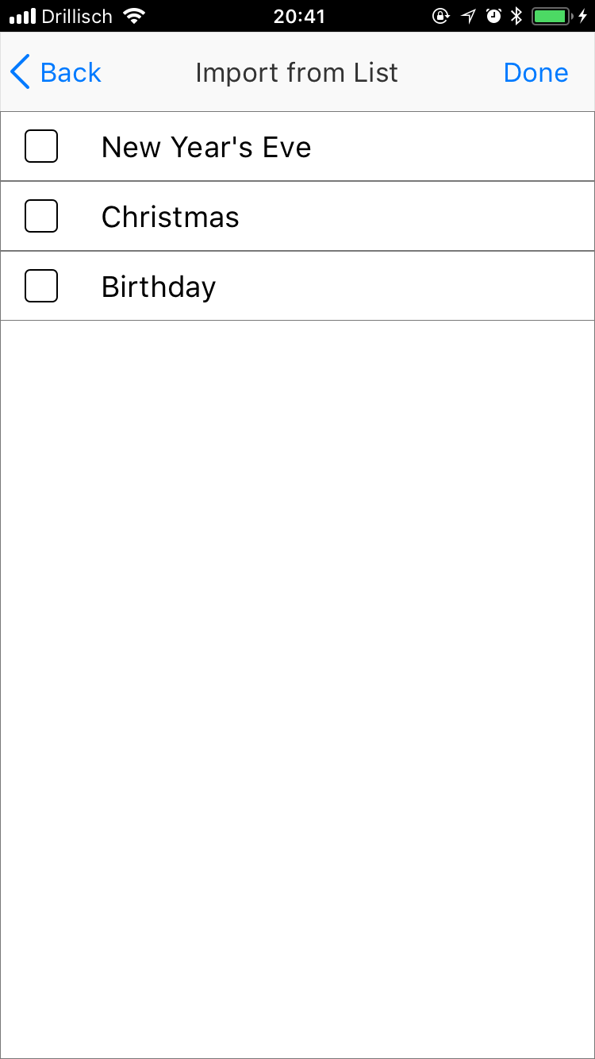
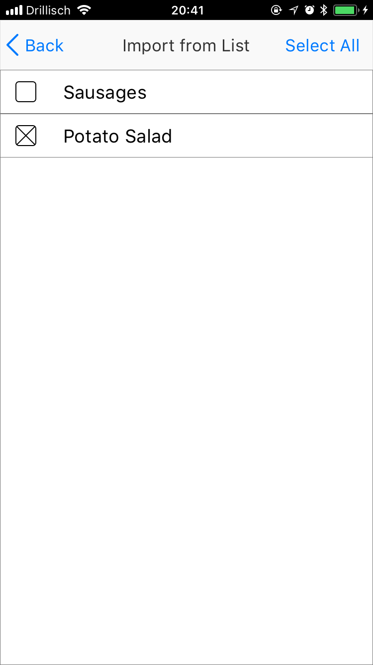
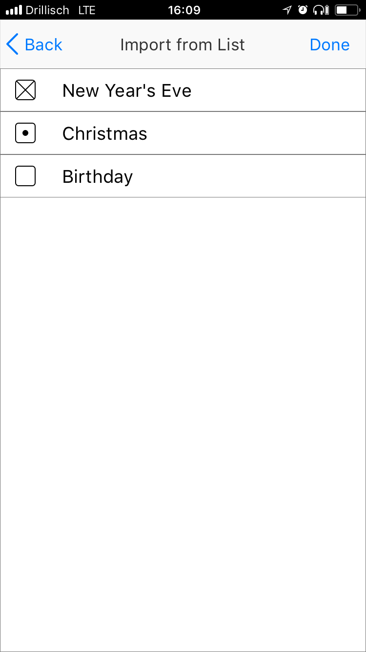
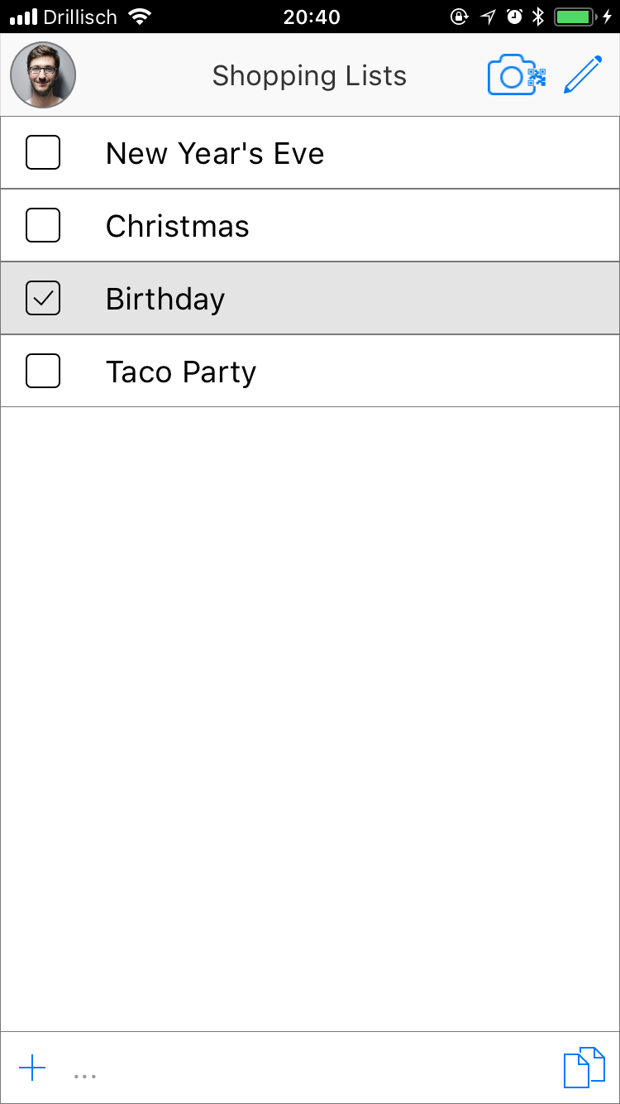
Create a new list with exisiting items by pressing the button in the right bottom
Add single items from a list. Lists that are chosen partially are marked with a „.“
Alternatively chose a complete list by checking the box in the left. These will be marked with an „x“.
Press „Done“ to add the new list to your home screen.

